Slide 1
Chapter 5
Interest Rates

Slide 2
Chapter Outline
5.1 Interest Rate Quotes and Adjustments
5.2 Application: Discount Rates and Loans
5.3 The Determinants of Interest Rates
5.4 Risk and Taxes
5.5 The Opportunity Cost of Capital

Slide 3
5.1 Interest Rate Quotes and Adjustments
The Effective Annual Rate
  Indicates the total amount of interest that will be earned at the end of one year
  Considers the effect of compounding
    Also referred to as the effective annual yield (EAY) or annual percentage yield (APY)

Slide 4
5.1 Interest Rate Quotes and Adjustments (cont'd)
Adjusting the Discount Rate to Different
Time Periods
  Earning a 5% return annually is not the same as earning 2.5% every six months.
General Equation for Discount Rate Period Conversion
    (1.05)^{0.5} – 1= 1.0247 – 1 = .0247 = 2.47%
      Note: n = 0.5 since we are solving for the six month
      (or 1/2 year) rate

Slide 5
Annual Percentage Rates
The annual percentage rate (APR), indicates the amount of simple interest earned in one year.
  Simple interest is the amount of interest earned without the effect of compounding.
  The APR is typically less than the effective annual rate (EAR).

Slide 6
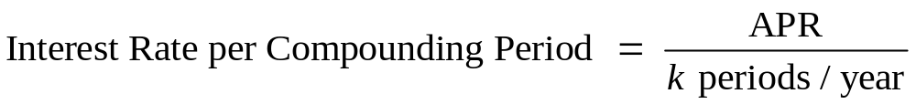
Annual Percentage Rates (cont'd)
The APR itself cannot be used as a discount rate.
  The APR with k compounding periods is a way
  of quoting the actual interest earned each
  compounding period:

Slide 7
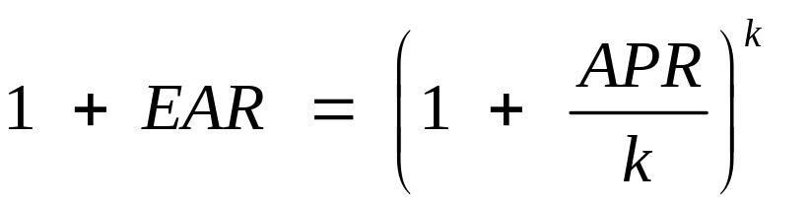
Annual Percentage Rates (cont'd)
Converting an APR to an EAR
  The EAR increases with the frequency of compounding.
    Continuous compounding is compounding every instant.

Slide 8
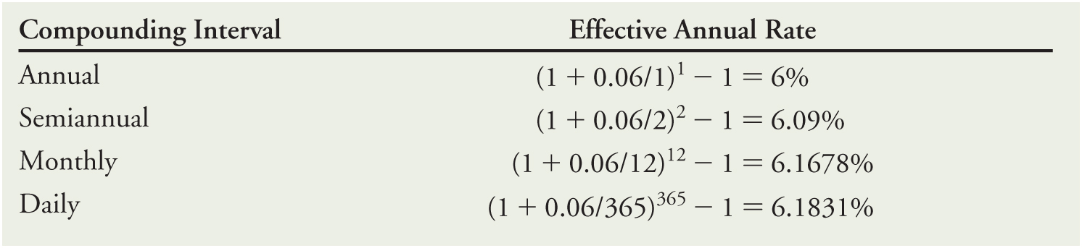
Annual Percentage Rates (cont'd)
Table 5.1 Effective Annual Rates for a 6% APR with Different Compounding Periods
  A 6% APR with continuous compounding results in an EAR of approximately 6.1837%.

Slide 9
5.2 Application: Discount Rates and Loans
Computing Loan Payments
  Payments are made at a set interval, typically monthly.
  Each payment made includes the interest on the loan plus some part of the loan balance.
  All payments are equal and the loan is fully repaid with the final payment.

Slide 10
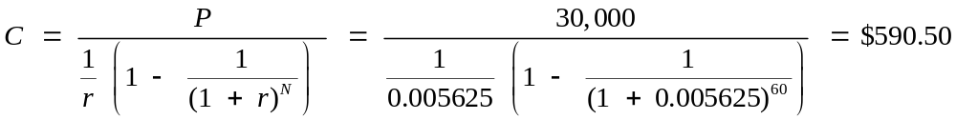
5.2 Application: Discount Rates and Loans (cont'd)
Computing Loan Payments
  Consider a $30,000 car loan with 60 equal monthly payments, computed using a 6.75% APR with monthly compounding.
    6.75% APR with monthly compounding corresponds to a one-month discount rate of 6.75% / 12 = 0.5625%.

Slide 11
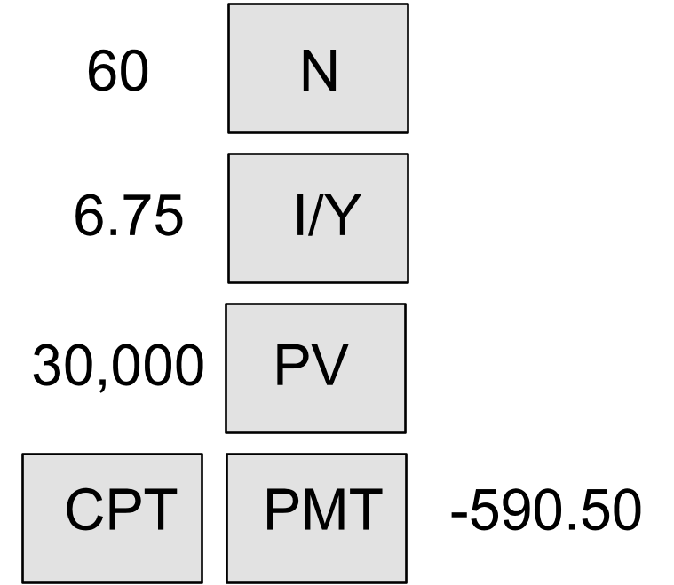
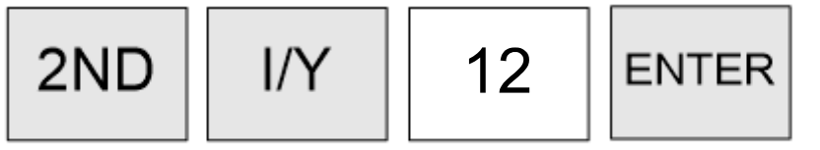
5.2 Application: Discount Rates and Loans (cont'd)
Computing Loan Payments
  Financial Calculator Solution

Slide 12
5.2 Application: Discount Rates and Loans (cont'd)
Computing the Outstanding Loan Balance
  One can compute the outstanding loan balance by calculating the present value of the remaining loan payments.

Slide 13
5.3 The Determinants of Interest Rates
Inflation and Real Versus Nominal Rates
  Nominal Interest Rate: The rates quoted by financial institutions and used for discounting or compounding cash flows
  Real Interest Rate: The rate of growth of your purchasing power, after adjusting for inflation

Slide 14
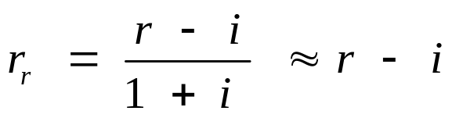
5.3 The Determinants of Interest Rates (cont'd)
The Real Interest Rate

Slide 15
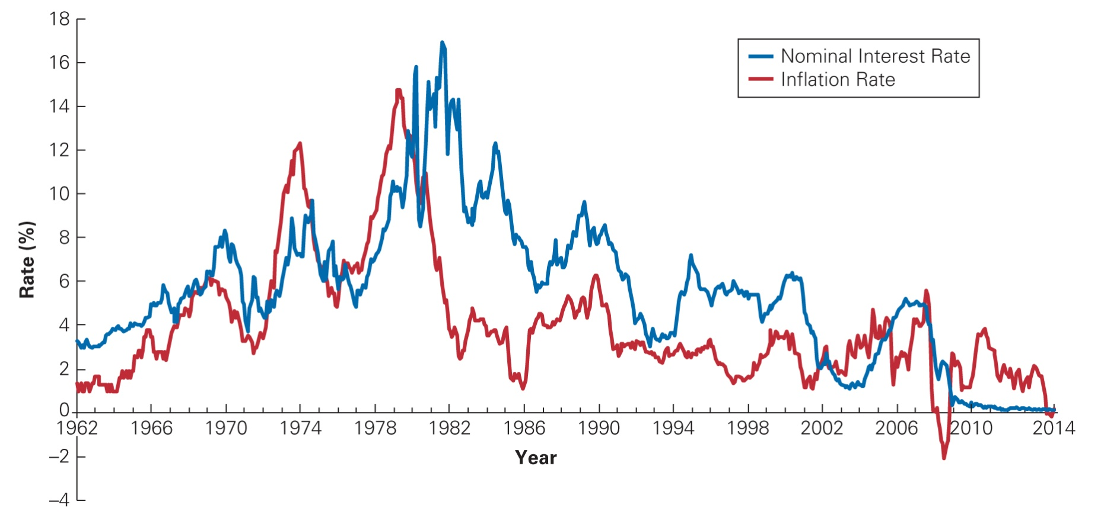
Figure 5.1 U.S. Interest Rates and Inflation Rates, 1962–2012

Slide 16
Investment and Interest Rate Policy
An increase in interest rates will typically reduce the NPV of an investment.
  Consider an investment that requires an initial investment of $10 million and generates a cash flow of $3 million per year for four years. If the interest rate is 5%, the investment has an NPV of

Slide 17
Investment and Interest Rate
Policy (cont'd)
  If the interest rate rises to 9%, the NPV becomes negative, and the investment is no longer profitable:

Slide 18
Monetary Policy, Deflation, and the 2008 Financial Crisis
When the 2008 financial crisis struck, the Federal Reserve responded by cutting its short-term interest rate target to 0%.
While this use of monetary policy is generally quite effective, because consumer prices were falling in late 2008, the inflation rate was negative, and so even with a 0% nominal interest rate, the real interest rate remained positive.

Slide 19
The Yield Curve and Discount Rates
Term Structure: The relationship between the investment term and the interest rate
Yield Curve: A graph of the term structure

Slide 20
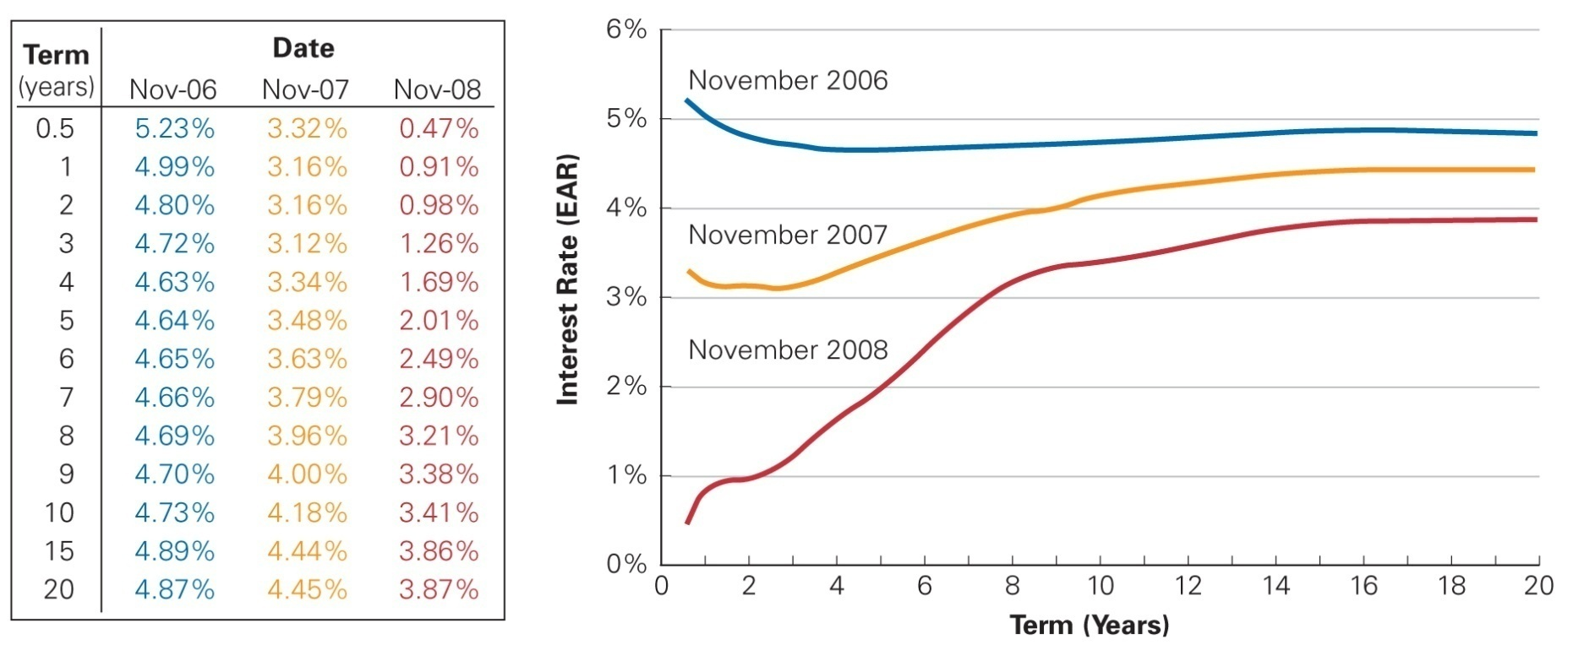
Figure 5.2 Term Structure of Risk-Free U.S. Interest Rates, November 2006, 2007, and 2008

Slide 21
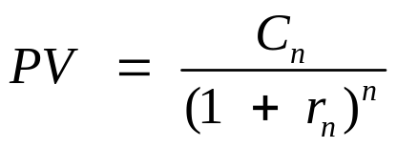
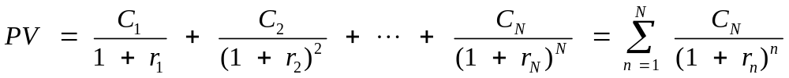
The Yield Curve and Discount Rates (cont'd)
The term structure can be used to compute the present and future values of a risk-free cash flow over different investment horizons.
  Present Value of a Cash Flow Stream Using a Term Structure of Discount Rates

Slide 22
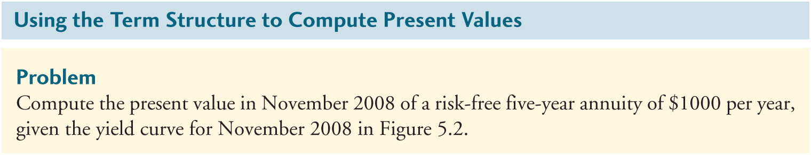
Textbook Example 5.5

Slide 23
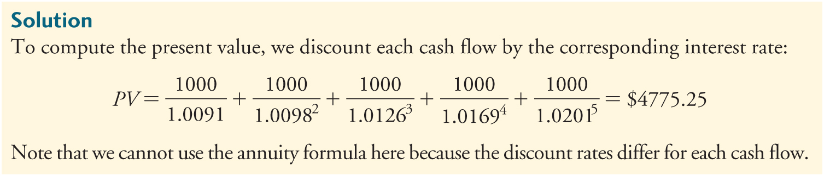
Textbook Example 5.5 (cont'd)

Slide 24
The Yield Curve and the Economy
Interest Determination
  The Federal Reserve determines very short-term interest rates through its influence on the federal funds rate, which is the rate at which banks can borrow cash reserves on an overnight basis.
  All other interest rates on the yield curve are set in the market and are adjusted until the supply of lending matches the demand for borrowing at each loan term.

Slide 25
The Yield Curve and the Economy
Interest Rate Expectations
  The shape of the yield curve is influenced by interest rate expectations.
    An inverted yield curve indicates that interest rates are expected to decline in the future.
      Because interest rates tend to fall in response to an economic slowdown, an inverted yield curve is often interpreted as a negative forecast for economic growth.
        Each of the last six recessions in the United States was preceded by a period in which the yield curve was inverted.
        The yield curve tends to be sharply increasing as the economy comes out of a recession, and interest rates are expected to rise.

Slide 26
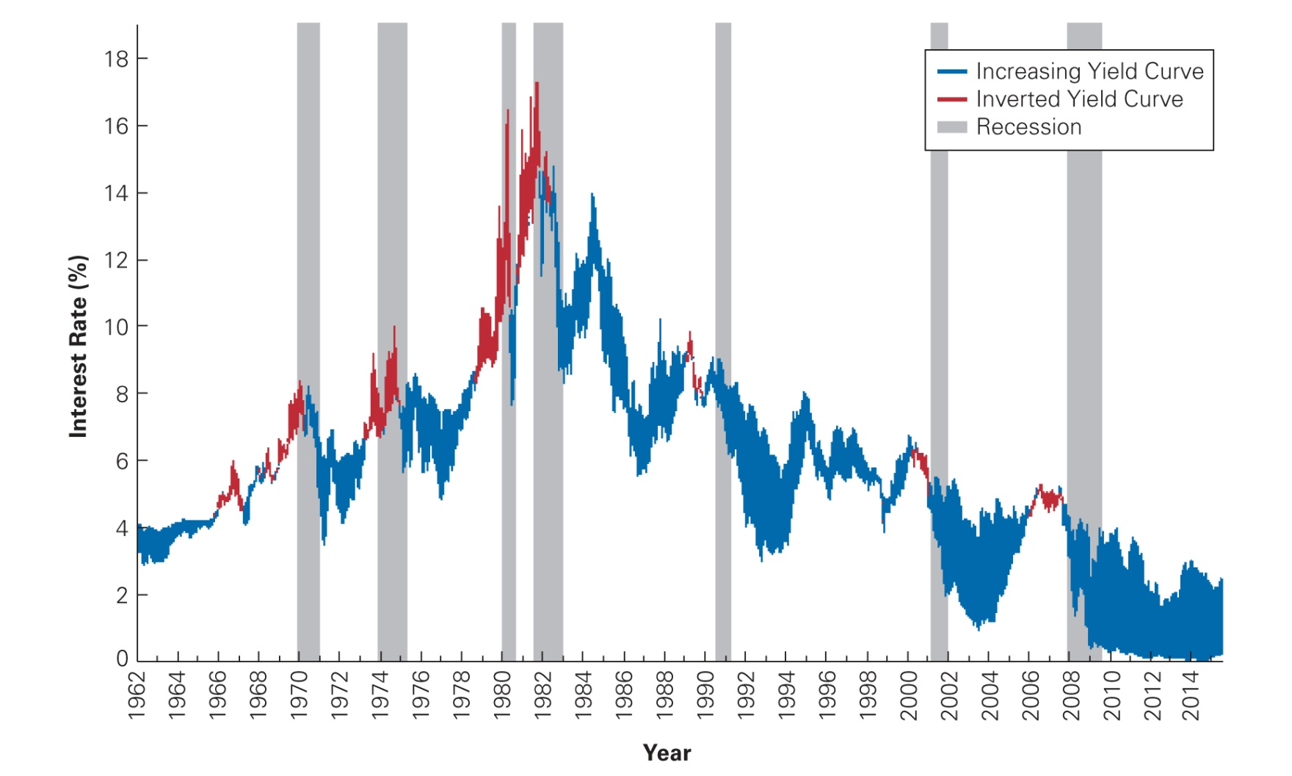
Figure 5.3 Short-Term Versus Long-Term U.S. Interest Rates and Recessions

Slide 27
5.4 Risk and Taxes
Risk and Interest Rates
  U.S. Treasury securities are considered “risk-free.” All other borrowers have some risk of default, so investors require a higher rate of return.

Slide 28
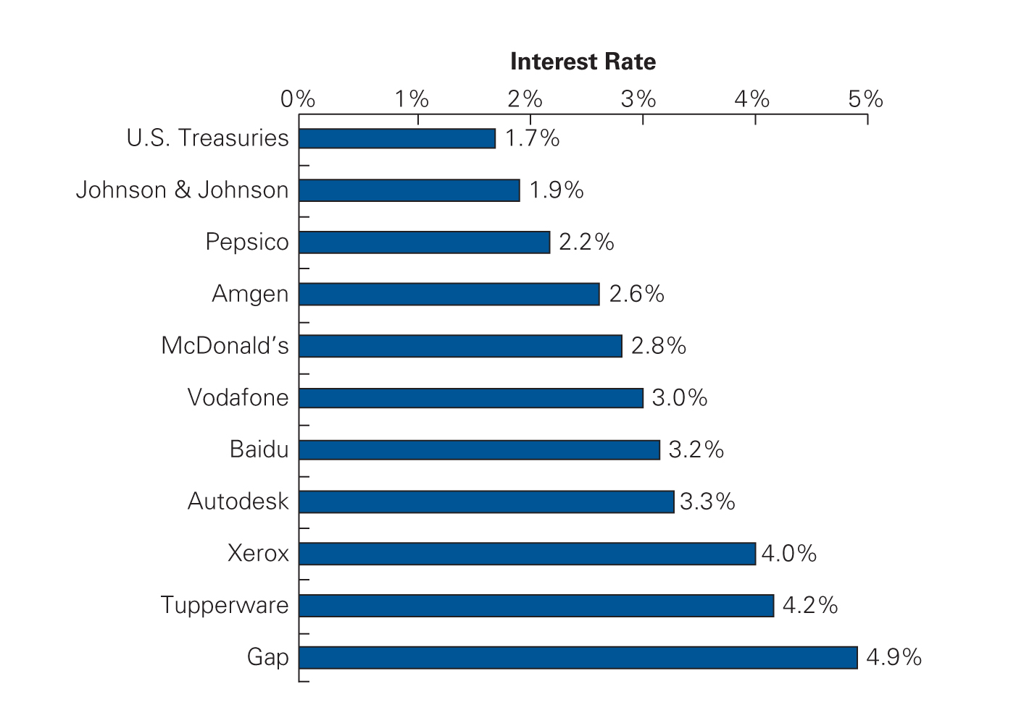
Figure 5.4 Interest Rates on Five- Year Loans for Various Borrowers, December 2015
Source: FINRA.org.

Slide 29
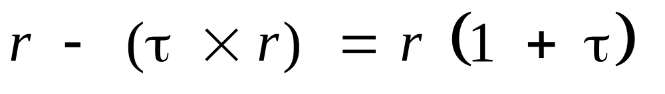
After-Tax Interest Rates
Taxes reduce the amount of interest an investor can keep, and we refer to this reduced amount as the after-tax interest rate.

Slide 30
5.5 The Opportunity Cost of Capital
Investor’s Opportunity Cost of Capital: The best available expected return offered in the market on an investment of comparable risk and term to the cash flow being discounted
  Also referred to as Cost of Capital

Slide 31
Chapter 5
Appendix

Slide 32
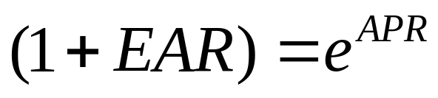
Continuous Rates and Cash Flows
Discount Rate of a Continuously Compounded APR
  Some investments compound more frequently than daily.
    As we move from daily to hourly to compounding every second, we approach the limit of continuous compounding, in which we compound every instant.
    The EAR for a Continuously Compounded APR

Slide 33
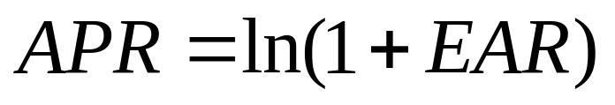
Continuous Rates and Cash Flows (cont’d)
Discount Rate of a Continuously Compounded APR
  Alternatively, if we know the EAR and want to find the corresponding continuously compounded APR, the formula is:
    The Continuously Compounded APR for an EAR
    Continuously compounded rates are not often used in practice.

